Slide 1
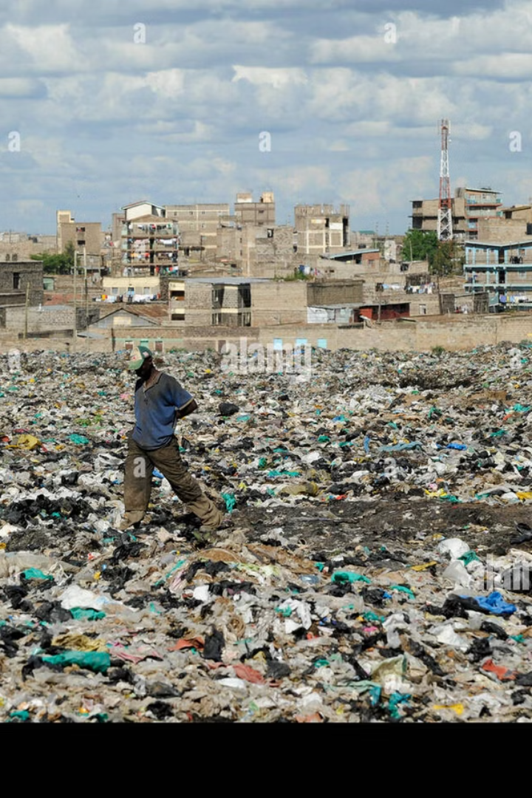


Sustainable Solutions for Waste and Housing
This presentation outlines an integrated solution to address the pressing global issues of waste generation and inadequate housing, in alignment with Sustainable Development Goals (SDGs) 11 and 7.
by Simon Nderitu

Slide 2
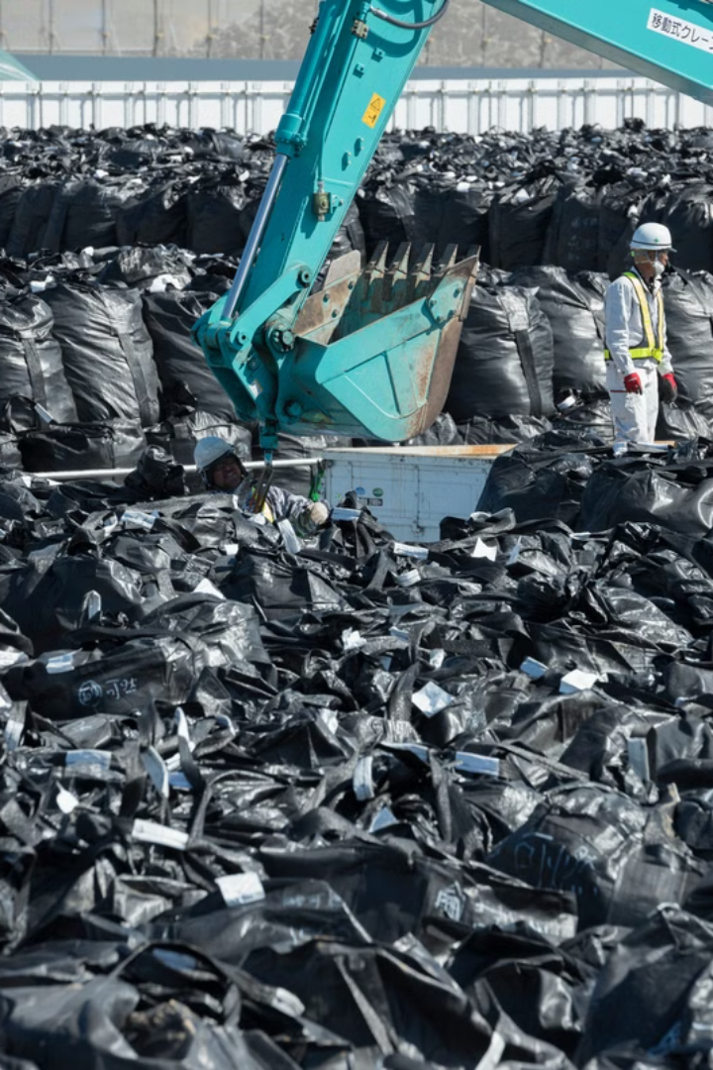
Problem Definition and Significance
1
Waste Crisis
2
Housing Shortage
Rapid urbanization and unsustainable consumption patterns have led to a global waste crisis, with landfills overflowing and the environment suffering.
Millions of people worldwide lack access to affordable and adequate housing, leading to the proliferation of informal settlements and slums.
3
Environmental and Social Impact
These challenges have severe environmental consequences, such as pollution and greenhouse gas emissions, as well as social implications, including health issues and lack of opportunity.

Slide 3
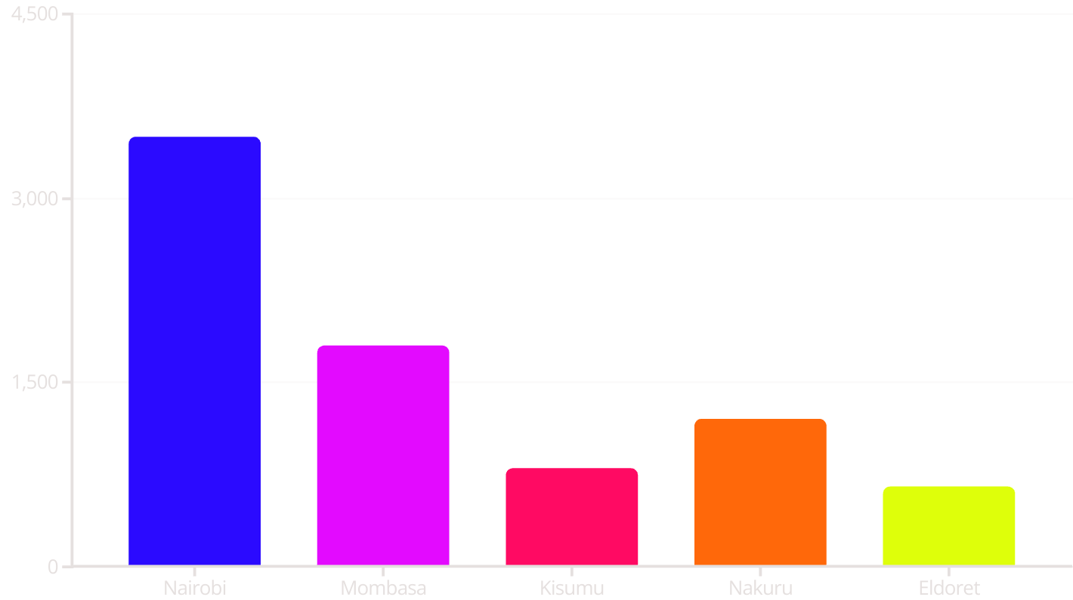
Data Trends on Waste Generation by Towns in Kenya
The bar chart illustrates the significant variation in daily waste generation across major towns in Kenya. Nairobi, as the capital and largest city, produces the most waste at 3,500 tons per day, followed by Mombasa, Nakuru, Kisumu, and Eldoret.

Slide 4
How Project Addresses SDG Problem
Sustainable Development Goal (SDG) Alignment
This project directly addresses SDG 11 (Sustainable Cities and Communities) and SDG 7 (Affordable and Clean Energy) by:
Waste Management
Implementing innovative waste-to-energy technologies to divert waste from landfills and convert it into clean, renewable electricity and fuel. This reduces greenhouse gas emissions and environmental pollution.
Affordable Housing
Leveraging sustainable construction methods and renewable energy sources to build high-quality, energy-efficient, and affordable housing units. This expands access to adequate shelter and clean energy.

Slide 5

Conclusion and Next Steps
Integrated Impact
Collaborative Approach
The proposed solution addresses the interlinked challenges of waste management and housing, creating a more sustainable and equitable future.
Successful implementation will require partnerships with local governments, communities, and other stakeholders to ensure widespread adoption and impact.
Continuous Improvement
The project will continue to monitor progress, gather feedback, and refine the strategies to maximize its effectiveness in achieving the SDG targets.

